Slide 1
Inaugural Alaska Food Festival and Conference
November 7-9, 2014
Notes:
Update the presentation with the organization’s name, location and the date you’re presenting. You can also add your own name on this title slide.

Slide 2
Community Emergency Food Preparedness
Darren Snyder
UAF Extension Agent
AFPC Governing Board Member

Slide 3
AFPC Goals targeted
Food is safe, protected and supplies are secure throughout Alaska.
Alaska’s food system is more sustainable.
Alaskans are engaged in our food system

Slide 4
Why Emergency Preparedness?
Because accidents happen, we need to have plans for successful outcomes

Slide 5
“Accidents” can be human-caused or nature-caused or both
Major earthquake - war/conflict - pandemic
Depending on severity they can result in disruptions in the normal supply chain functions

Slide 6
Why not do nothing?
Risk- because even if there’s a low probability for a major, catastrophic disaster causing the disruption of food shipments, there would be a very high consequence!

Slide 7
Why Community Preparedness?
Humans are social and we need each others help to thrive.
Truly prepared individuals are prepared to act to help others.
During a major disaster, communities may not be able to rely on outside sources for help.

Slide 8
Brace yourself!

Slide 9
How prepared are we? It depends; what, where, how big.
LEPC’s (Local Emergency Planning Committee)
AK State Emergency Operations Plan
DHS and EM (Div. of Homeland Security and Emergency Management)
VOAD’s (Volunteer Organizations Aiding in Disaster)
FEMA, APHIS (Federal Emerg. Mngmnt & Animal/Plant Health Serv.)
National Response Framework (NRF), Emergency Support Functions (ESF)

Slide 10
So…Where’s the Food?!
Food Banks
Alaska’s Federal Food Programs
Stores (retail, commercial, etc.)
VOAD’s
Alaska’s Catastrophic Food Reserve
Wild/Cultivated Harvestable

Slide 11
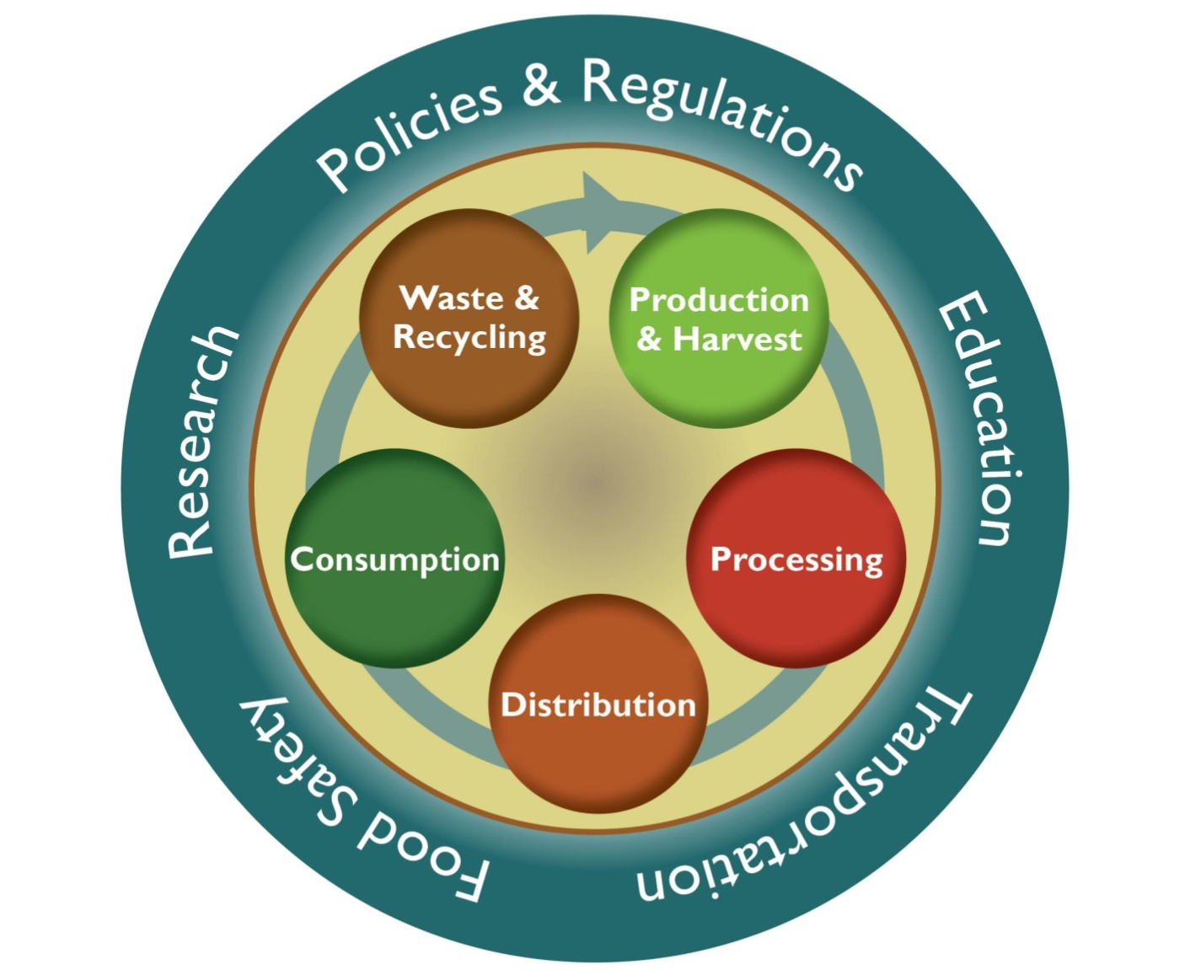
Our Food System
Notes:
Production/Harvest- agriculture, husbandry, fisheries, mariculture, subsistence or harvest of traditional “wild” foods
Processing – manufacturing, packaging, home-canning
Distribution – Retailers, Restaurants, Food Service, Manufacturing, Farmers Markets, CSA’s, Convenience Stores, Food Kitchens, Food Banks
Education – nutrition, cooking and preservation; workforce development
“… production issues (farmland preservation, farmers markets, household & community gardens), to processing
issues (local vs. external), to distribution issues (transportation, warehousing) to access issues (inner-city grocery
stores, co-ops, school breakfasts & lunches, food stamps, the WIC program, etc.), to use issues (food safety and
handling, restaurants, street vendors), to food recycling (gleaning, food banks, food pantries and soup kitchens) to
waste stream issues (composting, garbage fed to pigs, etc.).”22

Slide 12
During a multi-week supply disruption, my community would;
***Breakout activity – group by community****
experience what impacts?
have what responses?
have what unmet needs?
(consider elements of the Food System)

Slide 13
How can we prepare our communities?
By planning and creating a “culture of preparedness”.
Community Food Emergency and Resilience Plan (using the “Template”)
Alaska Community Emergency Food Cache System (ACEFCS)

Slide 14
Essential elements of the Template
Provides a framework for a community to engage, discuss and make steps towards self-reliance
Community outlines procedures and resources available in the event of a food emergency.

Slide 15
The Template helps the community to;
identify transportation system strengths and vulnerabilities
develop food storage and distribution capabilities

Slide 16
The Template helps community develop plans for Wild and Cultivated Harvests
Emergency Hunts, Fishing, Gathering (laws, authorization, protocols, shared resources for harvest/processing/distribution)
Compensation agreements for resources used (fuel, crops, supplies)

Slide 17
How can emergency food storage really work on a community scale?
ACEFCS!

Slide 18
The Alaska Community Emergency Food Cache System
The Big Idea;
Minimum levels of culturally appropriate, nutritionally qualified foods are determined, stocked and rotated as part of normal business operations in public-private partnerships with food vendors.

Slide 19
ACEFCS: some of the details
A Local Food Vendor (LFV) maintains an Emergency Food Cache (EFC)
LFV employees are trained as Emergency Food Responders (EFR)

Slide 20
ACEFCS: a few more of the details
During food emergency- EFR’s implement Food Security and Distribution Protocols including 1)securing and 2) distributing food reserves in pre-planned manner (to individuals or VOADs)

Slide 21
ACEFCS: an essential detail
Employee Self and Family Plans are developed including 1) vehicle, 2) home and 3) workplace emergency response kits, plans and supplies for the employee and family.
Allows first responders (EFRs) to stay on post during emergency

Slide 22
ACEFCS creates the opportunity to strengthen our food system and its abilities to weather emergencies.
Businesses maintain continuity of operations at least and even better – they grow!
Employees know they are taken care of
Communities are food secure in emergencies

Slide 23
Thank you for sharing in the Alaska Food Policy Council’s Vision:
A healthy, secure food system that feeds all Alaskans.
Questions? Thoughts? Ideas? Help?
contact; darren.snyder@alaska.edu
23

